Slide 1
Week 9:
Garbage Collection
Intro to Polymorphism
casting
.equals and .hashCode

Slide 2
Garbage Collection

Slide 3
Objects objects everywhere!
Every time the JVM encounters the new keyword, it instantiates a new object on the heap
But, what happens to the object when we don’t need it anymore?
In languages like C, we would need to manually dispose of the object so that we wouldn’t run out of space in the heap.

Slide 4
A little bit about garbage collection
The JVM has a special process that hunts for orphan objects in the heap.
An orphan object is an object that doesn’t have any reference variables pointing at it.
These orphan objects are removed from the heap to free up space.

Slide 5
Garbage Collection
Week-09-garbagecollection:Start

Slide 6
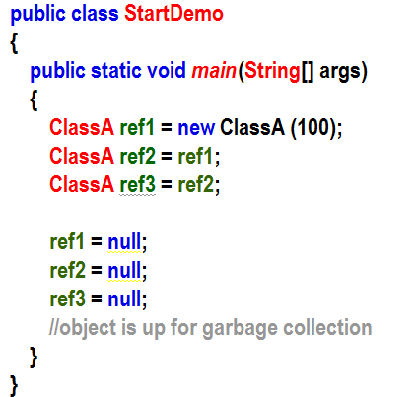
Stack
Heap
Static
Code
main
ClassA
object
100
ref3 = @
ref2 = @
ref1 = @

Slide 7
Stack
Heap
Static
Code
main
ClassA
object
100
ref3 = @
ref3 = null
ref2 = @
ref2 = null
ref1 = null
ref1 = @

Slide 8
Basic Polymorphism

Slide 9
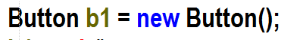
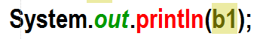
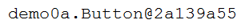
What does this really do?
Declares a reference variable called b1 of type Button
Instantiates a Button Object from the Button Class
Runs the Button Constructor
Returns the address of the Button Object (which is in the heap somewhere) to the reference variable b1.
b1 now holds the address of the Button Object
Sometimes, we say that b1 is the object for simplicity. (However, always remember that b1 holds the address of the object, not the object itself)

Slide 10
Polymorphism
The most POWERFUL pillar of the four pillars of OOP!
Can you remember the other three?

Slide 11
Introduction to Polymorphism (What is it?)
Huh?
OK, let’s figure this out
Polymorphism is a Greek word that means "many-shaped" and it has two distinct aspects: At run time, objects of a derived class may be treated as objects of a base class in places such as method parameters and collections or arrays
In computer science, it describes the concept that you can access objects of different types through the same interface. Each type can provide its own independent implementation of this interface.
Polymorphism means "many forms", and it occurs when we have many classes that are related to each other by inheritance.

Slide 12
Polymorphism
Objects can take on many forms

Slide 13
Polymorphism
Week-09-polymorphism1.Start – Part A

Slide 14
Polymorphism so far…
With polymorphism, we can set the reference variable type to a Parent class and instantiate the actual object as the child class.
We can only access methods in the child object that are present in the type of the reference variable that holds its address. Let’s check it out…

Slide 15
Polymorphism
Week-09-polymorphism1.Start – Part B

Slide 16
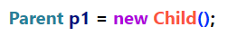
Reference Variable Filter
Child Object
method1
method2
method3
method4
method5
Parent Filter
method1
method3
p1.
Child has methods 1-5
Parent only has method1 and method3
Even though we have instantiated a Child object that contains all 5 methods, when we access it via our reference variable of type Parent, we can only see the methods accessible to Parent!
Think of it like a reference type filter.

Slide 17



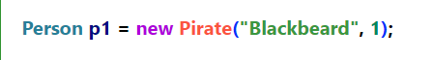
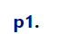
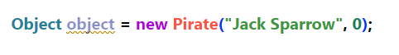
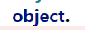
The importance of reference variable type
Do Piratey stuff (including stuff inherited from Person (and stuff inherited from Object)!!!
Can only do Person stuff (And stuff inherited from Object!!!)
Can only do Object stuff

Slide 18
Bottom Line
Even if the child object has a many methods, we can only access methods that are available to the reference variable type.

Slide 19
Yourturn1- Part A
8 minutes

Slide 20
Polymorphism
Week-09-polymorphism1.Start – Part C

Slide 21
Can we call people[0].eat()?
Can we call people[1].eat()?
Can we call people[2].eat()?
Can we call people[0].drawSword()?
@
@
@
If I type people [0], what kind of type lens does the JVM use to see that object?
Bottom line: Any object is seen through the lens of the reference Variable type
main
people
@

Slide 22
Yourturn1- Part B
8 minutes

Slide 23
Casting
We can make primitive variables pretend to be a different type than they are.
We call this casting.
To cast from a double to an int, we do the following:
int myInt = (int) 1.7;
myInt will be equal to 1
How do suppose you would cast a double into a float?
float myFloat = ??? 2589.5485

Slide 24
When do we get the error?
Widening casting means going from a smaller number of bits to a larger number of bits
Widening casting (happens automatically) vs narrowing casting (requires explicit casting)
Downcasting (narrowing)
Need to explicitly cast
No Problem!
double
float
long
int
short
byte
64 bit floating point
Possible Loss of precision error
32 bit floating point
64 bit integer
32 bit integer
16 bit integer
8 bit integer
Upcasting (widening)
Implicit (automatic)

Slide 25
Casting with reference variables works the same way but it is very powerful!

Slide 26
Polymorphism
Week-09-polymorphism1.Start – Part D

Slide 27
Casting using Polymorphism
Widening casting means changing our reference variable to be a parent of itself
Narrowing casting means changing our reference variable to be a child of itself
Widening casting (happens automatically) vs narrowing casting (requires explicit casting)
Methods that our reference variable has in them
No Problem!
We now have access to methods which may not exist in the object
All Object methods
All Object methods and all Person methods
All Object methods, all Person methods, and all Pirate methods
Downcasting (narrowing)
Need to explicitly cast
Upcasting (widening)
Implicit (automatic)

Slide 28
Casting
Remember, when upcasting (moving further up the inheritance chain), the compiler will implicitly cast for us. This is because we can’t break anything by upcasting.
However, when downcasting (moving further down the inheritance chain), we must tell the complier that we know what we’re doing by explicitly casting.
Remember that, if we downcast incorrectly, we can cause a runtime error!

Slide 29

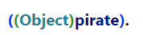
Casting our reference variable
Do Piratey stuff (including stuff inherited from Person (and stuff inherited from Object)!!!
Can only do Person and Object stuff
Can only do Object stuff

Slide 30
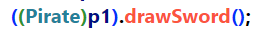
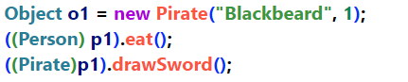

Let’s go the other way…
Can only do Person stuff (And stuff inherited from Object!!!)
Can now do piratey stuff!
Can only do Object stuff
Can do Object or Person stuff
Can do Object, Person, ore Pirate stuff

Slide 31
Yourturn1- Part C
8 minutes

Slide 32
Polymorphism
Week-09-polymorphism1.Start – Part E

Slide 33
@
@
@
Question: if I type people [0], what kind of object does the JVM see?
main
Can we call people[0].drawSword()?
people
@

Slide 34
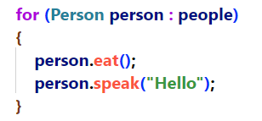
@
@
@
main
If we type:
people
@

Slide 35
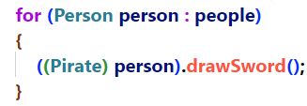
@
@
@
main
If we type:
Can we call people[0].drawSword()?
YES!!!
people
Can we call people[1].drawSword()?
@
NO!!! Runtime Exception

Slide 36
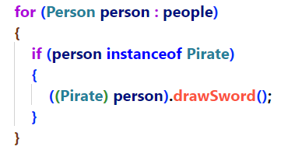
@
@
@
main
Aha!
people
@

Slide 37
Yourturn1- Part D
8 minutes

Slide 38
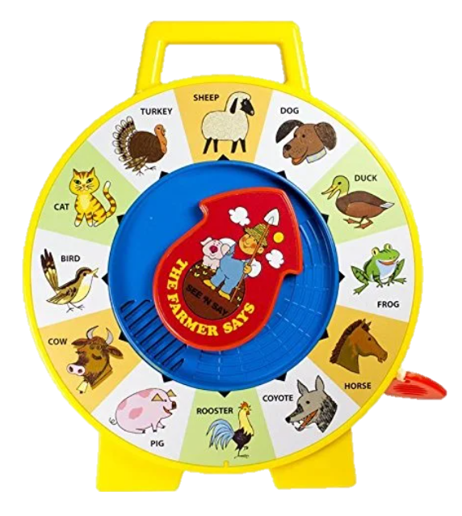
Your Turn 2

Slide 39
Polymorphism using interfaces
Week-09-polymorphism2.Start

Slide 40
Polymorphism so far…
With polymorphism, we can set the reference variable type to a Parent class (or implemented interface) and instantiate the actual object as the child class.
We can only access methods in the child object that are present in the type of the reference variable that holds its address. Let’s check it out…
Think about our smartphone example. Using polymorphism, we can access any object through the lens of the parent class or implemented interface that happens to be the type of the reference variable
Another way of saying this is that an object can take on the form of any parent in its hierarchy or any interface in its hierarchy. (Hence, Polymorphism or many forms!)

Slide 41
This is the clinical definition of Polymorphism
It is way more powerful than it seems right now.
Stay tuned…

Slide 42
Yourturn3
10 minutes

Slide 43
.equals and .hash
dotequals.Start-Part A

Slide 44
Figuring out equality in the world of objects
We can compare primitives directly with ==
However, objects are more complicated.
Judging what makes two objects equal will be different for different objects.
We need to build a method that allows us to compare objects.
That method is .equals

Slide 45
.equals and .hash – Let’s fix our code!
dotequals.Start-continued

Slide 46
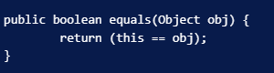
The Actual code for the .equals in the object class

Slide 47
.equals and .hash – Let’s fix our code!
dotequals.Start-continued

Slide 48
.hashCode
.hashCode is a method in the Object class.
When the hashCode method is not overridden by your class, the default hashcode method in Object runs
This returns some hash of the object’s memory address.
When you override hashCode, it must satisfy the following rules:
Hashcode must consistently return the same value whenever called on the same object.
If two objects are equal according to the .equals method, the hashCode method must return the same value for both objects
If two objects are NOT equal according to the .equals method, the hashCode method should try to return different values for each object but there is no guarantee.

Slide 49
4 Rules for writing .equals
Make sure you are overriding the .equals method
If the address of this object is the same as the object being compared, they are the same object and we immediately return true.
If the passed object is null, return false
If the passed object is not the same Class as this object, return false
If the fields that we deem important while judging if two objects are the same(for example, both have the same studentNumber), return true!
(remember, that if our .equals returns true, we must make sure that the .hashCode for both objects are the same!)
Or…Let VSCode do it for you!

Slide 50

Why can’t we just use .equals?
In theory, we could. However, depending on the objects we are comparing, out .equals might be very time consuming.
Imagine a String with 26000 characters and we have to compare each letter. Now, imagine we have to do that for 100000 Strings
.hashCode, however, is very fast. We do not need to visit every character to generate a hashcode.
Also, we know with 100% certainty that, if the hashcodes do not match, the objects are not equal. Calling this can eliminate the need to run the process-instensive .equals.
Ouch…my brain hurts…if only there was a way for VSCode to build .equals and .hashCode for us!

Slide 51
Bottom Line
We should always provide a means to determine if any two object of a particular Type are the same or different.
We use both .equals and .hashCode to do this.

Slide 52
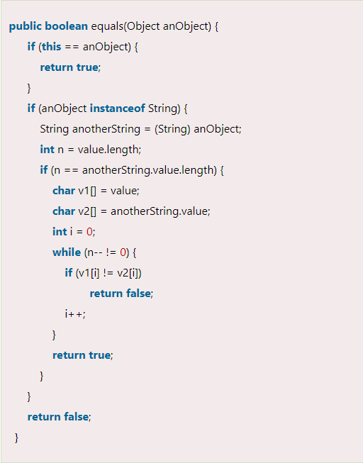
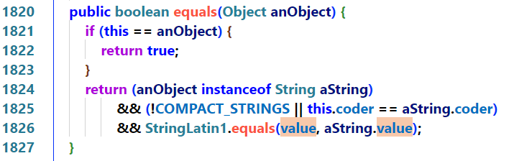
Just for fun – Two implementations of the .equals method in the String Class
If the address of this object is the same as the object being compared, they are the same object and we immediately return true.
If the passed object is null, return false
If the passed object is not the same Class as this object, return false
If the fields that we deem important to judging if two objects are the same(for example, both have the same studentNumber), return true!
(remember, that if our .equals returns true, we must make sure that the .hashCode for both objects are the same!)

Slide 53
By the way…VSCode will build Hashcode and equals for you…
Investigate the equals and hashCode builders in VSCode
Ooops ;-> Did I forget to tell you that before you did the last yourturn?

Slide 54
Yourturn4
10 minutes

